Slide 1
Assay Concentration Prediction Models
Daniel Altamirano
August 8, 2022

Slide 2
Motivation
We have a convolutional neural network (CNN) which classifies SofiaQ qualitative assay images into positive and negative results.
Is it possible to use a CNN trained on those same images to predict the concentration of the antigen?

Slide 3
Challenges
Limited number of images for training deep CNNs, which benefit from lots of data.
Using qualitative assay images as data for quantitative predictions.
The qualitative assay images may not have the information required to make a good quantitative prediction.
Qualitative assay are designed to separate the test response between positive and negative.
Quantitative assays are designed to separate the concentration levels from each other.
Prediction range of 0.25 to 256 (3 orders of magnitude).

Slide 4
Project Plan
Develop two methods for automating assay concentration prediction:
Analytical: use assay image features for curve fit regression.
Machine Learning (ML): use convolutional neural network for regression.
Analytical: extract feature (deltaSignal) and fit to curve.
ML: modify SofiaQ categorical CNN for output of continuous values.
Evaluate models independently and relative to each other.

Slide 5
Data Set
SARS-CoV-2 SofiaQ assay images.
Assays fluoresce under UV light and RGB images are captured.
Antigen concentrations used: 0, 0.25, 0.5, 1, 2, 4, 8, 16, 32, 64, 128, 256.
Labels of positive and negative are associated with each assay.
5,322 assays with concentrations available.

Slide 6
Full Data Set

Slide 7
Balanced Data Set

Slide 8
Dataset Partitioning
Training Dataset = Dataset * 0.70
Validation Dataset = Dataset * 0.15
Testing Dataset = Dataset * 0.15

Slide 9
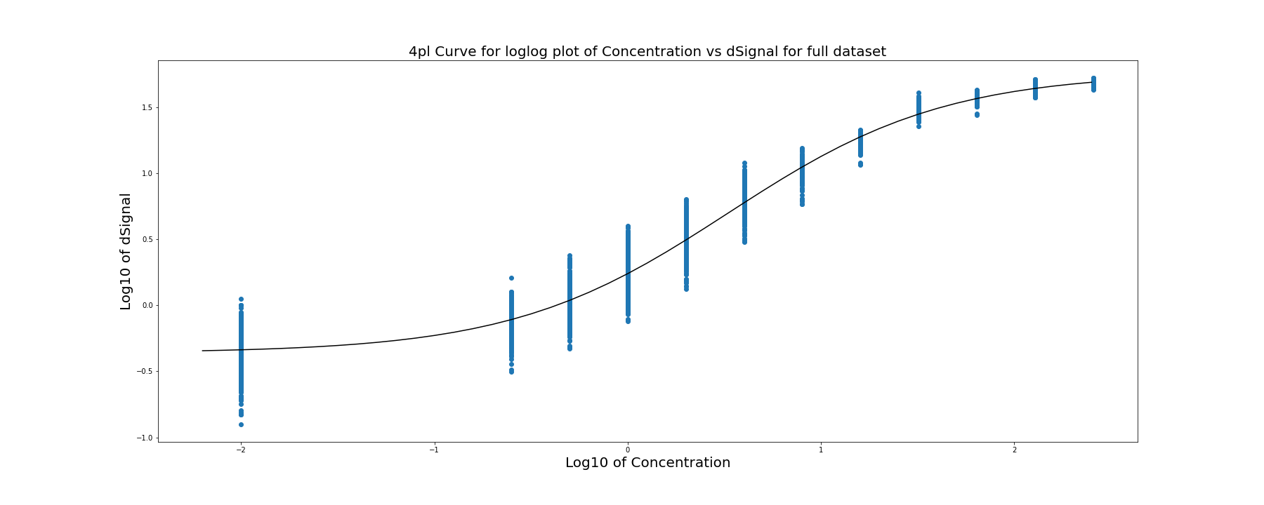
4PL Curve for Full Training Dataset

Slide 10
Artificial Neural Network
Network takes some input and produces a guess.
We measure the difference between that guess and the truth.
Then use that information to go back and update the network to improve its guesses.
Repeat.

Slide 11
Convolutional Neural Network
CNN takes an image as input and forward propagates through the NN.
The NN has layers of weights and non-linear, differentiable activation functions.
The CNN produces a prediction, and we measure the difference (called the loss) between that prediction and the truth.
Use the loss to backpropagate through the network and update its weights to minimize the loss.
Repeat until some stopping criteria.

Slide 12
Activation Functions
Why do they have to be non-linear and differentiable?
Non-linear: in order to extract non-linear features from the images.
Differentiable: so that the gradient of the loss w.r.t. the weights can be used to update (train) the network.
Gradient descent: going down the gradient to minimize the loss.
Backpropagation: using the chain rule to go back and update all the weights of the layers of the network.

Slide 13
Common Activation Functions
ReLU – rectified linear unit:
f(x) = max(0, x)
Most used activation function in CNNs.
Sigmoid – logistic function with range [0, 1]:
f(x) = 1 / ( 1 + e^(-x) )
Often used in classification.
Tanh – sigmoid function with range [-1, 1]:
f(x) = tanh(x)
Often used in classification.
Softmax – returns a probability distribution by category.
f(x)i = e^xi / sum( e^xj ) for j = 1…K.

Slide 14
Loss Functions
Classification
Categorical cross entropy – used with Softmax
Regression
Mean squared error
Mean squared logarithmic error – produced best results for this regression CNN
Mean absolute error
Mean absolute percentage error

Slide 15
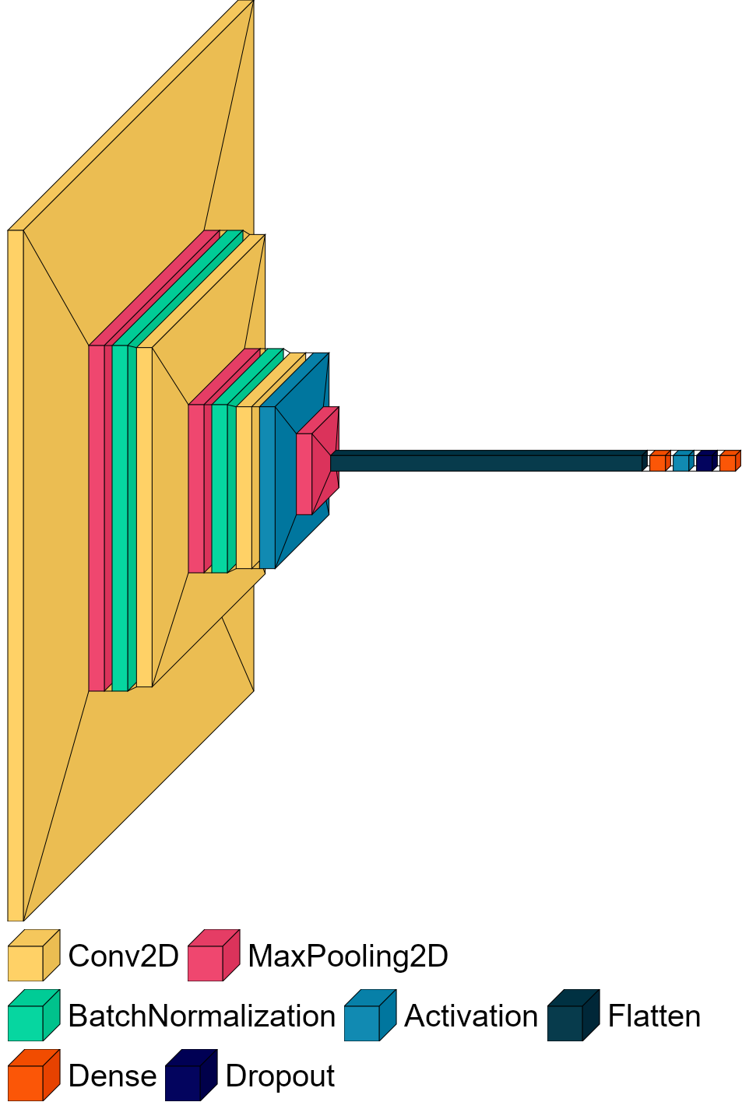
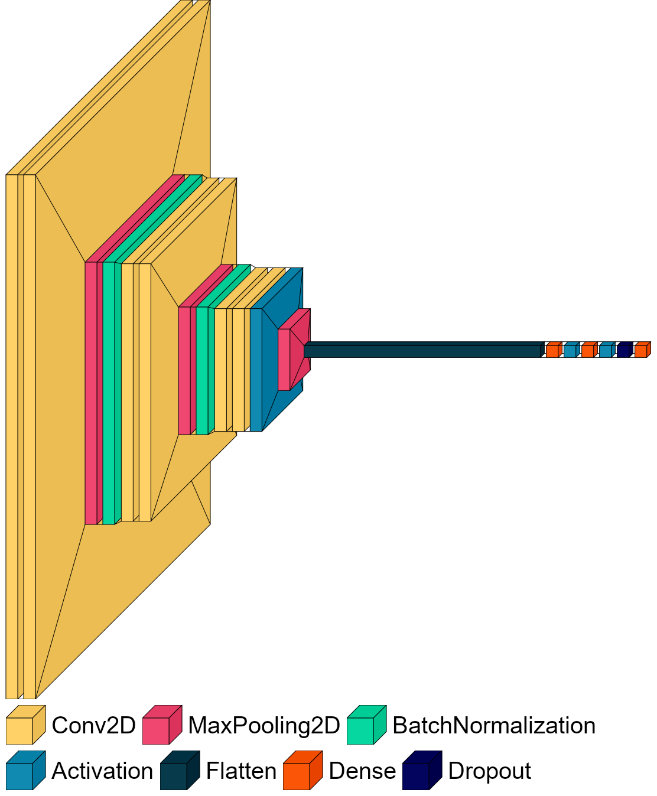
CNN Architecture
Baseline Categorical CNN
Regression CNN with 3 more ‘same’ convolutions and 3rd dense layer

Slide 16
Layers of a CNN
Convolutional: passes a 2D filter (e.g., of size 3 x 3) over the image.
Captures spatial information. Shares parameters.
Activation: enables model to learn non-linear features.
MaxPool: a 2D filter that passes on the maximum value.
Captures the most important features.
Reduces feature size.
BatchNormalization: normalizes hidden layers of the network.
Results in a normalized gradient, which allows for quicker learning.

Slide 17
Mean for 4PL – Full vs 30 Sample DS
Log2 by Log10
Log2 by Linear

Slide 18
Mean for CNN – Full vs Balanced DS
Log2 by Log10
Log2 by Linear

Slide 19
Mean for CNN vs 4PL – Full Dataset
Log2 by Log10
Log2 by Linear

Slide 20
Mean for CNN vs 4PL – Smaller DSs
Log2 by Log10
Log2 by Linear

Slide 21
Mean for CNN vs 4PL – Smaller DSs
Log2 by Log10
Log2 by Linear

Slide 22
CV for CNN vs 4PL – All Datasets

Slide 23
Results Table - CNN vs 4PL
 | Convolutional Neural Network |  |  |  |  |  | 4 Parameter Logistic Curve Fit
 | Full Data Set |  |  | Balanced Dataset |  |  | Full Data Set |  |  | 30 Samples Dataset
Concentration | Mean | SD | CV | Mean | SD | CV | Mean | SD | CV | Mean | SD | CV
0.00 | 0.133 | 0.167 | 1.251 | 0.228 | 0.202 | 0.884 | 0.049 | 0.069 | 1.418 | 0.038 | 0.053 | 1.392
0.25 | 0.377 | 0.176 | 0.468 | 0.371 | 0.235 | 0.632 | 0.208 | 0.153 | 0.732 | 0.226 | 0.182 | 0.807
0.50 | 0.612 | 0.215 | 0.352 | 0.552 | 0.315 | 0.570 | 0.513 | 0.277 | 0.539 | 0.601 | 0.255 | 0.424
1.0 | 1.063 | 0.299 | 0.281 | 0.931 | 0.322 | 0.346 | 1.119 | 0.568 | 0.508 | 1.148 | 0.419 | 0.365
2.0 | 2.007 | 0.375 | 0.187 | 1.525 | 0.281 | 0.184 | 2.138 | 0.808 | 0.378 | 2.198 | 0.975 | 0.444
4.0 | 3.902 | 0.809 | 0.207 | 3.612 | 0.850 | 0.235 | 4.174 | 1.330 | 0.319 | 4.968 | 1.333 | 0.268
8.0 | 9.095 | 1.641 | 0.180 | 8.209 | 1.322 | 0.161 | 7.202 | 1.929 | 0.268 | 7.652 | 1.958 | 0.256
16.0 | 20.968 | 2.174 | 0.104 | 17.035 | 1.818 | 0.107 | 13.857 | 2.331 | 0.168 | 13.891 | 2.157 | 0.155
32.0 | 43.486 | 4.822 | 0.111 | 34.026 | 4.543 | 0.134 | 41.053 | 15.043 | 0.366 | 38.901 | 10.326 | 0.265
64.0 | 79.176 | 20.577 | 0.260 | 65.549 | 13.536 | 0.207 | 72.187 | 29.039 | 0.402 | 66.693 | 14.687 | 0.220
128.0 | 162.626 | 30.474 | 0.187 | 98.254 | 11.156 | 0.114 | 185.290 | 79.129 | 0.427 | 193.212 | 71.082 | 0.368
256.0 | 238.123 | 34.435 | 0.145 | 145.409 | 14.366 | 0.099 | 249.985 | 60.928 | 0.244 | 227.197 | 66.405 | 0.292

Slide 24
Results
Best performance for mean:
4PL curve fit using the full dataset
CNN trained on full dataset
Best performance for CV:
CNN trained on full dataset
CNN trained on balanced dataset
Performance vs CV target:
No method was able to consistently get below the 10% CV target.

Slide 25
Alternate AI Methods
Use pretrained CNNs for evaluating images.
Standard method of adding/modifying a few final layers in the NN.
Transfer and few-shot learning may be applicable (SOTA).
Use line scan as input for an AI method.

Slide 26
Methods in Quantitative Assay Context
How might the analytical and artificial intelligence methods perform on a quantitative assay?
Quantitative assay images would contain more information:
Greater statistical separation between concentration levels.
It’s possible both methods would improve.
Would have to implement methods on quantitative data to know.

